Slide 1
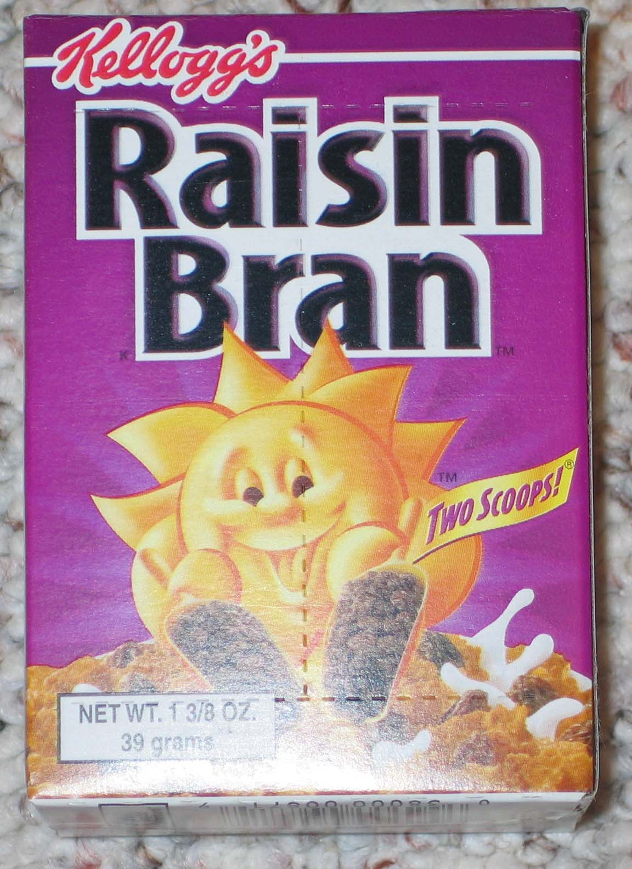
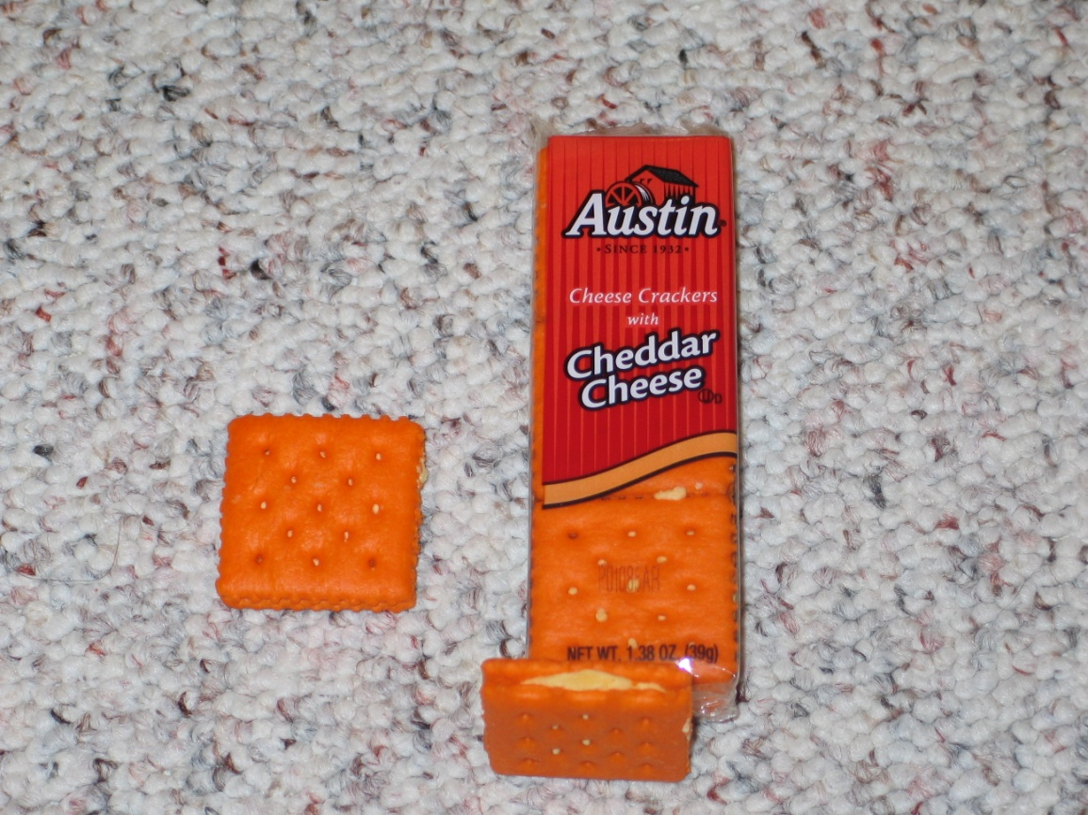
Water Activity

Slide 2
Water Activity
Experiment 1
Room Temperature
Relative
Humidity RH = 75%
15%
Moisture
Cracker
Initial Moisture = 3%
3%
Time

Slide 3
Water Activity
Experiment 2
Room Temperature
50%
Relative
Humidity RH = 75%
Moisture
Cheese
25%
Initial Moisture = 50%
Time

Slide 4
Water Activity
Experiment 3
Room Temperature
Relative
Humidity RH = 75%
Cracker
15%
Cheese
25%
Water ???
Is water transferred from the cheese to the cracker? Or vice versa?

Slide 5
Water Activity Concept
Water vapor in air
biomaterial (proteins, carbohydrates, fat
water, minor components)
water in the biomaterial
Insulation
At Equilibrium
f : Fugacity of the component (water)
For a real system

Slide 6
Water Activity
Temperature (ºC) | Pressure (Bars) | Fugacity (bars) | Fugacity coefficient
0.01 | 0.00611 | 0.00611 | 1
10 | 0.01227 | 0.01226 | 0.9992
20 | 0.02337 | 0.02334 | 0.9988
50 | 0.12336 | 0.12291 | 0.9954
70 | 0.31163 | 0.30955 | 0.9933
100 | 1.0132 | 0.99856 | 0.9855
200 | 15.550 | 14.278 | 0.9182
300 | 85.916 | 67.367 | 0.7841

Slide 7
Water Activity
Relative humidity

Slide 8
Water Activity
Room Temperature
Relative
Humidity RH = 75%
Cracker
15%
Cheese
25%
Water ???
Is water transferred from the cheese to the cracker?
What are the water activities of the cheese and the cracker?

Slide 9
Water will be transferred
from the raisins to the cereal
How we can reduce the transfer of
water so the raisins do not get
hard and the cereal soggy?
We can lower the water activity
of the raisin or increase the water
activity of the cereal
From a practical standpoint is better to decrease the water activity
of the raisins for example using glycerol (taste??).

Slide 10
Water Activity Calculations
x: Molar fraction
Using Raoult Law
For ideal systems
Water molar fraction
in the biomaterial
m_{w}: molar concentration of water (mol/liter)
m_{s,i}: molar concentration of solutes (mol/liter)
N_{w}: moles of water
N_{s,i}: moles of solutes

Slide 11
Water Activity Calculations (Ideal Systems)
Very large molecules, for example starch, have little
influence on the water activity (Why?)
Water insoluble components (e.g. fats) have no
influence on water activity
Small molecules (e.g. sucrose) have large influence
on water activity. Addition of these solutes decreases the water activity

Slide 12
Calculate of the water activity lowering of a 1 molal NaCl
NaCl
Na⁺ + Cl⁻
1 Molal = 1 mole of solute per 1000 grams of solvent
Molecular weight of NaCl = 58.5 grams
Due to dissociation
Assume equal to 1
for ideal systems

Slide 13
EFFECT OF SUCROSE ON a_{w}
g Sucrose /kg water | Ideal a_{w} | Actual a_{w} |  | % Sucrose
116 | 0.994 | 0.994 | 1 | 10.4
342 | 0.982 | 0.980 | 0.998 | 25.5
1368 | 0.932 | 0.904 | 0.97 | 57.8
2322 | 0.891 | 0.814 | 0.914 | 69.9

Slide 14
Other Equations to calculate a_{w} for non-linear systems
Osmotic pressure

Slide 15
Other Equations to calculate a_{w} for non-linear systems

Slide 16
Non-linear behavior is caused by:
Dissociation of solute
Solute molecular size (parameter q)
Solvent-solute interaction
Strong attraction between the solvent and the solute
Low attraction between the solvent and the solute. the solute molecules tend to associate each other
Calculate the water activity of a 25% solution of glucose assuming ideal behavior.
What would be the effect of solute size on the result assuming that i.e. there is no interaction between the solute and the solvent and the volume ratio
glucose/water is 6? What is your conclusion

Slide 17
Water Activity and Food Safety/Quality

Slide 18
How is water associated to biomaterials?
Water type IV. Pure water full activity (very reactive state)
Water type III. Water trapped in tissues, it behaves almost ideally
Water type II. Water H-bonded to solutes and tied to membrane surfaces. This water has solution properties and deviate from ideal behavior in capillaries < 1 diameter
Water type I. “Monolayer” of water adsorbed to solutes and surfaces, this water has a very high deviation of the ideal behavior

Slide 19
Water Activity and Moisture Content
Moisture Isotherms
Moisture Content (g water/100 g dry solids)
Moisture Isotherm
0
Water activity a_{w}
1

Slide 20
Water Activity and Moisture Content
Moisture Isotherms
Water
type II
Water
type I
Water
type III
0.5
Very dry foods
Pasta, coffee
Jams, semi-moist foods

Slide 21
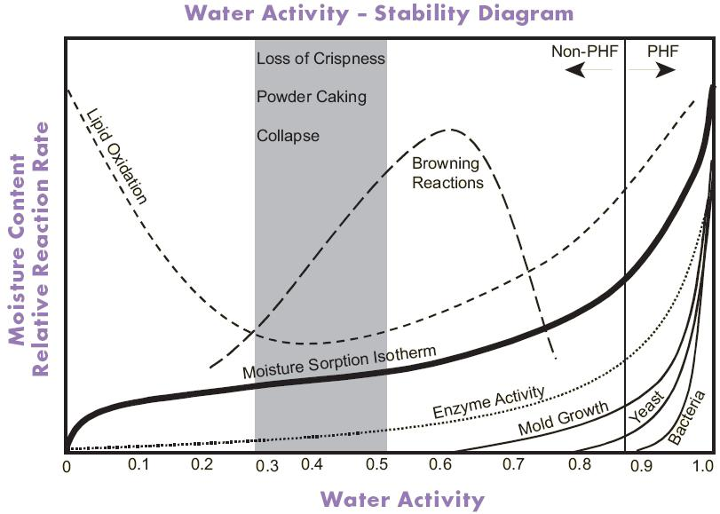
PHF: Potential Hazardous Foods

Slide 22
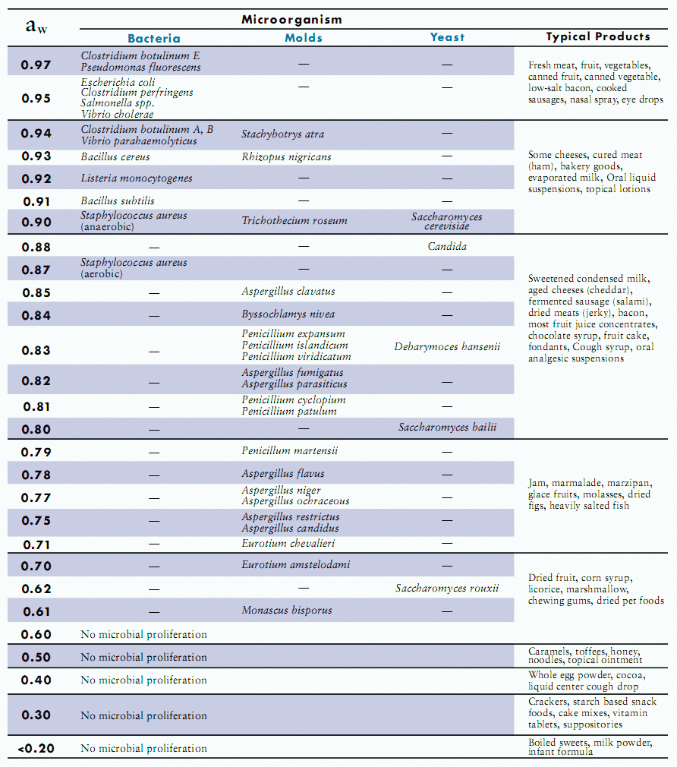

Slide 23
Water type III (excellent carrier, it improves microbial growth)
Water type II
Water type I
This water is tightly bonded, it does not flow
Sustrate

Slide 24
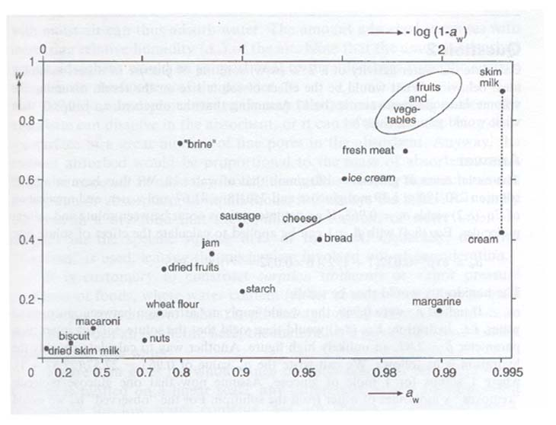
Moisture Content (g H₂O/g solid

Slide 25
Water Activity and Moisture Content
Moisture Isotherms
How could we describe
this isotherm?
m
Moisture Content (g water/100 g dry solids)
Moisture Isotherm
0
Water activity a_{w}
a_{w}
1

Slide 26
Moisture Isotherms
BET model (Brunauer, Emmet and Teller)
Only a “monolayer” interacts with the surface
The energy of interaction is the same for each molecule
There are several energies associated with the absorption of water on substrates
Read about differences between absorption and adsorption

Slide 27
Evaporate and
break bounds
reality
Evaporate
Food/
Biomaterial
m_{o :} water “monolayer”
Moisture content

Slide 28
Moisture Isotherms
BET model (Brunauer, Emmet and Teller)
c and m_{o} are parameters
of the model
Slope
c and m_{o} can
be calculated
Intercept

Slide 29
Moisture Isotherms
BET model (Brunauer, Emmet and Teller)
How could we calculate ?
Clausius-Clayperon Equation

Slide 30
Calculation of
ln a_{w}
m₄
m₃
m₂
m₁
1/T

Slide 31
Sorption Isotherms at different temperatures

Slide 32
Sorption Isotherms of Wheat Flour at different temperatures
20ºC |  | 40ºC |  | 50ºC
a_{w} | m(%) | a_{w} | m(%) | a_{w} | m(%)
0 | 0 | 0 | 0 | 0 | 0
0.12 | 6.9 | 0.13 | 5.9 | 0.15 | 5.4
0.23 | 8.6 | 0.28 | 7.7 | 0.31 | 7.4
0.43 | 10.5 | 0.45 | 10.0 | 0.47 | 9.6
0.62 | 13.9 | 0.63 | 13.1 | 0.64 | 12.6
0.76 | 17.4 | 0.78 | 16.8 | 0.79 | 16.3
0.89 | 25 | 0.90 | 24.2 | 0.90 | 24.0
Calculate the Sorption Enthalpy

Slide 33
Sorption Enthalpy
At 10% moisture
25% Moisture
10% Moisture
At 25 % moisture

Slide 34
Evaporate and
break bounds
reality
Evaporate
Food/
Biomaterial
m_{o}
Moisture content

Slide 35
Effect of water activity on
the sorption enthalpy,
Effect of temperature on
the sorption isotherm

Slide 36
Moisture Isotherms
GAB Equation
The GAB equation has three parameters K, C and m₁

Slide 37
Water Activity and Moisture Content
Moisture Isotherms
Crystalline Materials
Very ordered, three-dimensional arrangement of molecules, very stable
thermodynamically. The crystals have little pores and water interact with
polar groups in the crystal surfaces, although the surface can be large there
is no much interaction of water and crystalline structures
Amorphous Materials
They lack of molecular order, amorphous materials exhibit two different
states that is glassy and rubbery states. An amorphous glassy material has
a very high viscosity and very low mobility. The conversion from an
amorphous glassy state into a amorphous rubbery state occurs at the glass
transition temperature. The glass transition temperature Tg can be
achieved by increasing the temperature or increasing the amount of
water (plasticizer).

Slide 38
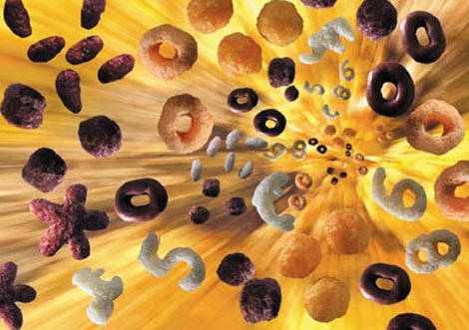

Extruded Products
Glass Transition Concept

Slide 39
RAW MATERIAL
Composition: Oil, starch, protein, fiber
Moisture
Particle Size
Additives
DIE PROFILE
Open Area
Flow Resistance
PRODUCT QUALITY
Product Moisture
Product Temperature
Bulk Density or Expansion
Morphology
Shape
Size
Uniformity
Texture/Sensory
WSI/WAI
Gelatinisation
Dextrinisation
Expansion
OPERATIONAL VARIABLES
Feed Rate
Water Addition
Screw Speed
Screw Profile
Cutter Speed
Barrel temperature
SYSTEM PARAMETERS
SME
Residence Time
Thermal Energy
Product Temperature
Product Pressure
Melt Viscosity
SME: Specific Mechanical Energy
WAI: Water Absorption Index
WSI: Water Solubility
GELATINISATION
DEXTRINISATION (Molecular Degradation)

Slide 40
Glass Transition
RUBBERY STATE
Increasing temperature
Glass transition temperature ºC
Increasing moisture
GLASSY STATE
Moisture Content (%)

Slide 41
TRANSFORMATIONS OF RAW
MATERIALS DURING EXTRUSION
LIQUID
(AMORPHOUS)
Flashing Off Moisture
Heating
Glass Transition
Temperature
TEMPERATURE
Expansion
Cooling
GLASS
Dry Material
Wetting and Mixing
MOISTURE

Slide 42
Moisture Isotherms and crystallinity of the material
Lactose
The product can hydrogen-bond
water internally, not only in the
surface
Moisture Content (g water/100 g dry solids)
3% crystallinity
65% crystallinity
Water activity a_{w}

Slide 43
Moisture Isotherms and crystallinity of the material
6
120
Moisture
Crystallinity
90
Moisture (%)
3
60
Crystallinity (%)
30
0
0
10
20
30
Time (days)

Slide 44
Moisture Isotherms
Anticaking agent
All sites and
capillaries are
binding water
Deliquescence ?
Moisture content (%)
Typical Food
Crystalline material
Material starts
to dissolve
Water activity a_{w}

Slide 45
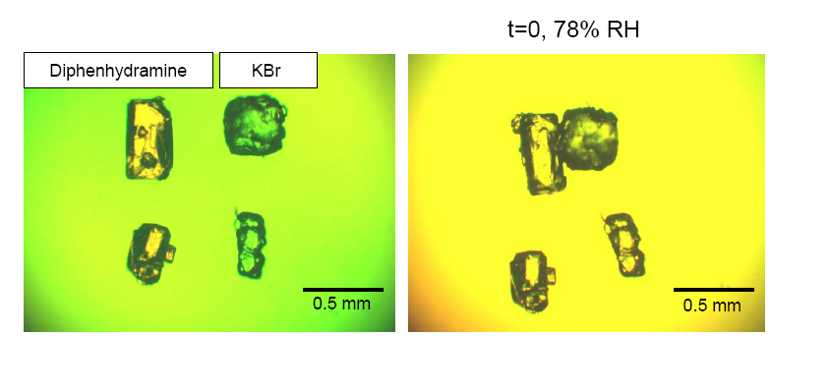
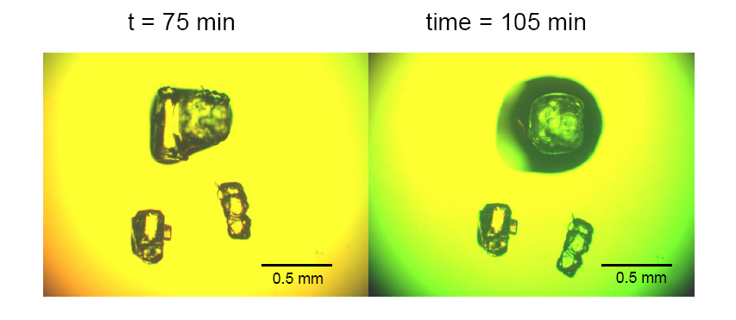
Deliquescence

Slide 46
a_{w} versus moisture content
Let’s see how we can estimate the water activity if we know the moisture
content (dry weight) of the material.
Let’s assume that the sorption isotherm is described by the BET model
BET Equation
We can solve the quadratic
equation and get a_{w}

Slide 47
What happens if the sorption is described for a a more complicated
equation such for example the GAB equation or other equation? Getting
a_{w} is more complicated because the resulting equation is not a quadratic equation
For example let’s work with the BET equation to understand the concept
of what we will do when we have to work with a more complicated equation (e.g.
the GAB equation).
BET Equation
Using Mathcad

Slide 48
Let’s assume that we have the following sorption isotherm for flour at 20ºC
a_{w} | % moisture (db)
0 | 0
0.12 | 6.9
0.23 | 8.6
0.43 | 10.5
0.62 | 13.9
0.76 | 17.4
0.89 | 25
Calculate the parameters of the BET equation and estimate the water
activity for a moisture content of 20% (db)

Slide 49
c = 5.9653
m_{o}= 2.91

Slide 50
Using GAB Equation
Non-linear Regression

Slide 51

Water Activity – Dry Ingredients Mixing
When ingredients having different water activities
are mixed, during storage moisture may be exchanged
between the ingredients until a final equilibrium water
activity is achieved. Dry materials may gain moisture
from the filling and lose desirable crispness, whereas
semi-moist fillings dry out or become gummy, sticky or hard.
X
(e.g raisin)
a_{eq}
m_{xi}
Y
(e.g cereal)
Moisture content
m_{yi}
Water activity

Slide 52
Water Activity – Dry Ingredients Mixing
Initial moisture
of ingredients
Water activity of
The whole product
Sorption isotherm
for each ingredient
Stability of
the ingredients
Quality of the product

Slide 53
Water Activity – Dry Ingredients Mixing
How could we calculate a_{eq}?
a_{eq}
1
m₁
If we assume that the isotherm
can be fitted as m = b a_{w} + c
Moisture content (gH₂O/g dry solid)
2
m₂
Water activity
From a mass balance for two components
W₁, W_{2,}…..W_{i} are weights of each component (dry weight)
and for n components
a⁰_{w1} , a⁰_{w2} , , a⁰_{w2} are the initial water activity of each component of the mixture

Slide 54
Water Activity – Dry Ingredients Mixing
How could we get dry weights from the wet weights?
Moisture content
In wet basis
The main problem with the above calculation is that we need to assume
that the sorption isotherm is a straight line. That sometimes may give us
problems to make the calculations.

